Slide 1

Could Artificial General Intelligence Become a Reality?
Week of January 26
Jacob Appling

Slide 2
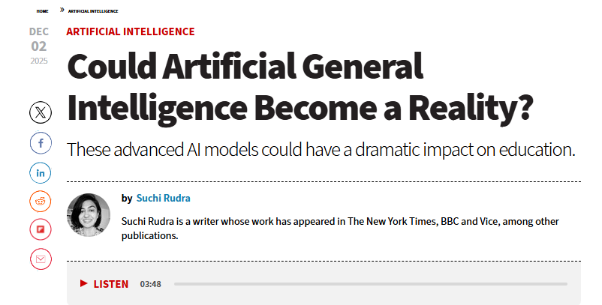
Article #4 (Row 4 via Google Sheet)

Slide 3
Link to the Source
https://edtechmagazine.com/k12/article/2025/12/could-artificial-general-intelligence-become-reality

Slide 4
Main Findings
Definition and Current State: The article explains Artificial General Intelligence (AGI) as AI systems capable of broad human-level problem-solving—not just narrow tasks like current generative AI. AGI remains undefined by consensus, but generally implies reasoning, planning, sensing, and acting across varied domains.
Progress and Debate: Some recent AI models (e.g., GPT-4.5) show impressive abilities—passing the Turing Test in limited settings—yet researchers agree this does not prove true human-level intelligence. Current systems still struggle with deep reasoning, long-term planning, and alignment with human values.
Requirements for AGI: Achieving AGI will require significant breakthroughs: new algorithms, improved memory/context handling, real-world awareness, and possibly new computing paradigms.
Potential in Education: If realized, AGI could transform teaching and learning—acting as adaptive tutors and learning partners, reshaping personalized instruction, custom assessments, and emphasizing higher-order skills like critical thinking and human-AI collaboration.

Slide 5
Broader implications for society
Transformative Impact: AGI promises to fundamentally change fields such as education by enabling deeply personalized learning and potentially redefining the roles of educators and learners alike.
Governance and Ethics: The article highlights that safety standards, ethical guidelines, and governance systems must be developed in tandem with AGI to mitigate risks—especially around fairness, accountability, and alignment with human values.
Uncertain Timeline: Experts emphasize timing is unclear—AGI might eventually emerge, but not necessarily soon or predictably without major scientific and technological advances.
Contrasting Views (Wider Context): Separate discourse in tech circles (e.g., DeepMind and others) shows tension between optimism about AGI’s potential for societal benefit and concerns about existential or misuse risks. (e.g., experts warn of infrastructure threats and call for careful regulation.)

Slide 6
Relevance and potential influence on the construction industry
Future of Design & Planning: AGI could revolutionize building design, construction planning, and simulation by reasoning across complex datasets—optimizing structural layouts, sustainability, and schedule coordination in ways far beyond current tools.
Automation & Robotics Integration: With true AGI, construction could see smarter autonomous robots capable of adapting in real-time to physical environments, improving safety, efficiency, and on-site decision-making.
Skills & Workforce: As in education, AGI would heighten the importance of human-AI collaboration skills—construction professionals might focus more on oversight, problem framing, and creative problem solving rather than routine tasks.
Governance & Ethics: Construction’s heavy reliance on safety standards, compliance, and risk mitigation would make ethical and governance frameworks for AGI especially crucial to prevent misuse, bias, and unintended consequences on job roles and workplace safety.

